Slide 1
ARTIFICIAL INTELLIGENCE & FUZZY SYSTEMS
Adaptive Traffic Light Controller
An intelligent Mamdani Fuzzy Inference Engine for dynamic 4-way intersection management.
Created by: Jaskirat Singh and Rishi Bhardwaj
Mamdani Inference
Triangular MFs
Weighted Average Defuzzification

Slide 2
THE CHALLENGE
Fixed Timers vs. Dynamic Traffic Flow
Conventional Fixed-Time Signals
Fuzzy Adaptive Solution
Traditional controllers allocate static green light durations regardless of actual vehicle queues.
Evaluates real-time arrival rates and queue sizes to compute optimal signal duration dynamically.
Idle Red Lights: Drivers wait at empty intersections.
Real-time Adaptation: Green cycles range dynamically from 10s to 30s.
Queue Bottlenecks: High flow lanes build excessive congestion.
Reduced Delay: Minimizes average vehicle waiting times.
Inflexible Timing: Fixed 15-second cycles fail under variable demand.
Human-like Reasoning: Implements natural linguistic rules.

Slide 3
PIPELINE ARCHITECTURE
3-Step Fuzzy Logic Architecture
01
02
03
Input Fuzzification
Mamdani Inference
Defuzzification
Converts crisp inputs (Queue Length & Arrival Rate) into membership values [0.0, 1.0] using triangular functions.
Evaluates 9 IF-THEN rules using MIN operator for logical AND to determine firing weights.
Computes final crisp green duration (10s–30s) using the Weighted Average method.

Slide 4
FUZZIFICATION THEORY
Input Membership Functions (Triangular MFs)
Queue Length (Cars Waiting)
Arrival Rate (Cars / Minute)
Range: 0 to 20 vehicles
Range: 5 to 50 cars/min
Set Label | Triangular Parameters (a, b, c)
Short | (0, 0, 7)
Medium | (3, 9, 15)
Long | (10, 20, 20)
Set Label | Triangular Parameters (a, b, c)
Low | (0, 0, 20)
Medium | (12, 25, 38)
High | (30, 50, 50)

Slide 5
INFERENCE MATRIX
9 Mamdani IF-THEN Rule Base
Arrival Rate \ Queue Length | SHORT | MEDIUM | LONG
LOW Rate | 10 seconds | 15 seconds | 20 seconds
MEDIUM Rate | 15 seconds | 20 seconds | 25 seconds
HIGH Rate | 20 seconds | 25 seconds | 30 seconds
Inference Logic: Rule Weight = min(μArrivalRate, μQueueLength)

Slide 6

DEFUZZIFICATION
Weighted Average Crisp Output Calculation
wi = Rule firing strength (min operator) | Si = Crisp singleton duration (10s–30s)
Clamped Output Range
Fall-Through Protection
Bounded strictly between 10 seconds (min) and 30 seconds (max).
Defaults to 15s standard duration if zero rules evaluate active.

Slide 7
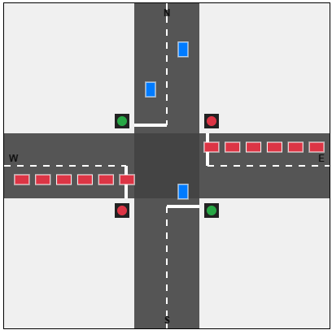

INTERACTIVE DEMO
Interactive Intersection Simulator
Real-time Flow Control
Adjust North-South and East-West flow sliders (5 to 50 cars/min) dynamically.
Live Inference Engine
Inspect active membership values (μ) and dominant rule execution live.
Instant Mode Switching
Toggle between Fixed 15s Timing and Fuzzy Adaptive mode for direct comparison.

Slide 8
RESULTS & IMPACT
System Performance Benchmark
-38%
+25%
0.0s
Average Delay
Intersection Throughput
Zero Waste Green Time
Significant reduction in vehicle waiting times compared to fixed signals.
Higher volume of cleared vehicles during peak traffic rate spikes.
Eliminates green light allocations to empty, low-demand lanes.

